Slide 1

FlowLayout
BorderLayout
GridLayout
CardLayout

Slide 2
Layout Managers
Automatically positions controls within windows.
Whenever a container is resized (or sized for 1st time), it is used to position each component.
Display components using L→R, Top→Bottom organization.
Keeps track of a list of components by their names and notified each time we add a new component.
Java has several predefined Layout Manager classes.
  Flow, Border , Grid and Card Layout
We can also position controls manually.

Slide 3

Since the Component class defines the setSize() and setLocation() methods, all Components can be sized and positioned with those methods.
Problem: the parameters provided to those methods are defined in terms of pixels. Pixel sizes may be different (depending on the platform) so the use of those methods tends to produce GUIs which will not display properly on all platforms.
Solution: Layout Managers. Layout managers are assigned to Containers. When a Component is added to a Container, its Layout Manager is consulted in order to determine the size and placement of the Component.
NOTE: If you use a Layout Manager, you can no longer change the size and location of a Component through the setSize and setLocation methods.

Slide 4
Layout of Components
BorderLayout
  north, south, west, east & center
FlowLayout
  left to right & top down
CardLayout
  stack of panels
GridLayout
  tabular form (rows & columns)

Slide 5
Layout Managers set over the frame:
setLayout(new BorderLayout());
setLayout(new CardLayout(());
setLayout(new FlowLayout());
setLayout(new GridLayout(rows,columns,xgap,ygap));
Default layout managers
  Windows (Frames & Dialogs) :BorderLayout
  Panels (Applets) :FlowLayout

Slide 6
FlowLayout
Default layout manager.
Implements a simple layout style, similar to words in a text editor.
Components are laid out from the upper-left corner, L→R, T→B.
Constructors:
  FlowLayout( ) :creates default layout, which centers components and leaves 5 pixels space between each component.
  FlowLayout(int how) : specify how each line is aligned.
  Values for how:
      FlowLayout.LEFT
      FlowLayout.CENTER
      FlowLayout.RIGHT
  FlowLayout(int how, int horz, int vert) :specifies horizontal and vertical space.

Slide 7
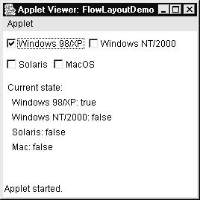
Example

Slide 8
How to Use FlowLayout?
import java.awt.*;
public class TestFlowLayout {
public static void main(String[] args){
Frame f = new Frame("TestFlowLayout");
f.setSize(200,200);
f.setLayout(new FlowLayout());
f.add(new Button("Button 1"));
f.add(new Button("Button 2"));
f.add(new Button("Button 3"));
f.add(new Button("Button 4"));
f.add(new Button("Button 5"));
f.setVisible(true);
}
}

Slide 9
public class FlowLayout1 extends Frame
{
FlowLayout1()
{
// set left-aligned flow layout
setLayout(new FlowLayout(FlowLayout.LEFT,10,10));
Checkbox winXP = new Checkbox("Windows XP", null, true);
Checkbox winVista = new Checkbox("Windows Vista");
Checkbox solaris = new Checkbox("Solaris");
Checkbox mac = new Checkbox("Mac OS");
add(winXP);
add(winVista);
add(solaris);
add(mac);
setVisible(true);
}

Slide 10
BorderLayout
Implements a common layout for top-level windows.
4 narrow, fixed-width components at the edges and one large area in the center.
  4 sides referred as north, south, east, west.
  Middle area called as center.
Constructors:
  BorderLayout( ) :creates a default border layout.
  BorderLayout(int horz, int vert) :specifies the horizontal and vertical space between components
    Following constants specify the regions:
      BorderLayout.CENTER
      BorderLayout.SOUTH
      BorderLayout.EAST
      BorderLayout.WEST
      BorderLayout.NORTH

Slide 11
How to Use BorderLayout?
import java.awt.*;
public class TestBorderLayout {
public static void main(String[] args){
Frame f = new Frame("TestBorderLayout");
f.setSize(200,200);
f.add("North", new Button("North"));
f.add("South", new Button("South"));
f.add("East", new Button("East"));
f.add("West", new Button("West"));
f.add("Center", new Button("Center"));
f.setVisible(true);
}
}

Slide 12
public class BorderLayoutDemo extends Frame
{
BorderLayoutDemo()
{
setSize(500,500);
setLayout(new BorderLayout());
setBackground(Color.RED);
Panel p=new Panel();
add(p,BorderLayout.NORTH);
p.add(new Label("wedew"));
p.add(new Label("The footer message might go here."));
p.add(new Button("Right"));
p.add(new Button("Left"));
p.setSize(200,200);

Slide 13
Border Layout (cont)
The regions of the BorderLayout are defined as follows:
North
West
Center
East
South

Slide 14
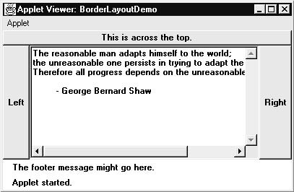
Example

Slide 15
GridLayout
Lays out components in 2-D grid.
We can define no. of rows, columns in constructors:
  GridLayout( ) :creates a single-column grid.
  GridLayout(int numRows, int numColumns )
    specifies no. of rows and columns.
      If numRows =0 means unlimited-length columns.
      If numColumns=0 means unlimited-length row.
  GridLayout(int numRows, int numColumns, int horz, int vert): specifies horizontal and vertical space between components.

Slide 16
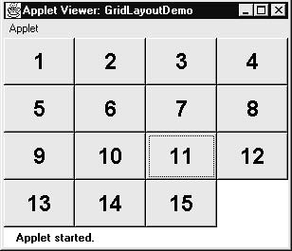
Example

Slide 17
How to Use GridLayout?
import java.awt.*;
public class TestGridLayout {
public static void main(String[] args){
Frame f = new Frame("TestGridLayout");
f.setSize(200,200);
f.setLayout(new GridLayout(2,3));
f.add(new Button("Button 1"));
f.add(new Button("Button 2"));
f.add(new Button("Button 3"));
f.add(new Button("Button 4"));
f.add(new Button("Button 5"));
f.setVisible(true);
}
}

Slide 18
public class GridLayoutDemo extends Frame
{
GridLayoutDemo()
{setLayout(new GridLayout(10, 10));
for(int i = 0; i < 10; i++)
{
for(int j = 0; j < 10; j++)
{
int k = i * 10 + j;
if(k > 0)
add(new Button("" + k));
}
}
setVisible(true);
}

Slide 19
CardLayout
Stores several different layouts.
Each can be treated as a separate index card in a deck that can be shuffled so that any card is on top at a given time.
Useful for user interfaces with optional components that can be dynamically enabled and disabled upon user input.
Constructors:
  CardLayout( ) creates a default card layout.
  CardLayout(int horz, int vert):specifies horizontal and vertical space between components.

Slide 20
CardLayout(contd.)
How to make card for the deck-
  Cards are the objects of Panel.
  Panel must have CardLayout selected as its layout manager.
  To add cards to a panel:
    void add(Component panelObj, Object name)
      name- name of card panels added to a panel
  Add this panel to main applet panel.
Now, provide a way to select any card.
  →Include a button for each card in deck.
After creation of deck, program activates a card by calling one of the following methods
  void first(Container deck) or void last(Container deck) or void next(Container deck) or void previous(Container deck) or void show(Container deck, String cardName)
    deck -Reference to container (usually a panel) that holds the cards.
    cardName - name of a card.

Slide 21
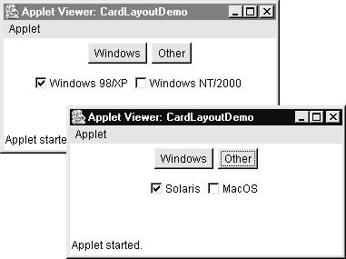
Example

Slide 22
How to Use CardLayout?
import java.awt.*;
public class TestCardLayout {
public static void main(String[] args){
Frame f = new Frame("TestCard Layout");
f.setSize(200,200);
f.setLayout(new CardLayout());
f.add("GraphicsPanel",new GraphicsPanel());
f.add("LabelPanel",new LabelPanel());
f.add("ButtonPanel",new ButtonPanel());
f.setVisible(true);
}
}

Slide 23
What if I don’t want a LayoutManager?
LayoutManagers have proved to be difficult and frustrating to deal with.
The LayoutManager can be removed from a Container by invoking its setLayout method with a null parameter.
Panel aPanel = new Panel();
aPanel.setLayout(null);
Ch. VIII - <number>

